Slide 1
TRANSITION PLUS
Training Veterans
and
Transforming Rural Communities

Slide 2
Problem
We are failing our veterans transitioning to civilian life.
Career Change
Purpose in Life
Adjust Mentally, Emotionally, Spiritually and Physically
These things Take TIME - which they don’t get

Slide 3
Result: Chance for substance abuse, homelessness and suicide.
“More than 20 percent of veterans with PTSD also suffer from an addiction…” Addictioncenter.com
“Daily, around 20 veterans commit suicide. Veterans’ suicides account for 18% of the suicide deaths in the country, while they only make up 8.5% of the adult population.” U.S. Department of Veterans Affairs

Slide 4
Mission
To give the needed time to transitioning military to discover a new career path, purpose for life, and healing from inward wounds, we will provide affordable housing, access to healthcare, agricultural and small business education, all in a quiet area ready for rural renewal.

Slide 5
Career Change --
Agricultural Interest – (40% want to farm)
Introduce to small Ag Businesses without Steep $ Barriers

Slide 6
Where we are Now
Our Phase 1 -
High tech Areoponic Tower Farm
Bee Keeping training with a Partnership with SAVE Farm in Manhattan (Open to all Bee Learners) due to GI Bill stipulations)

Slide 9
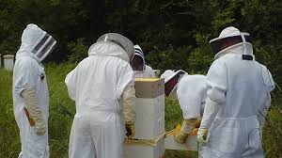

Slide 10
SAVE Farm Partnership – They need 1 ½ million lbs. of honey!

Slide 11
Summerfield has a lot of land and willing people who want bees and beekeepers on their property.

Slide 12
Where We Hope to Go in the Future
Phase 2 - Goat Herding, Chicken and Egg Production
Phase 3 - Other small business endeavors like:
Health and Well-Being, Construction Arts, Sustainable Energy with Solar and Wind Farm Technology

Slide 13
Progress on Phase 1 -
Secured former school building from the city of Summerfield for a low lease

Slide 14
Insured Building, Employees, and Students

Slide 15
Restored heat to School Cleaned up Building from being closed up

Slide 16
Have a Project Manager and Assistant working on Tower Start.

Slide 17
Have a dedicated Grant Writer who applied for a Americorp group of 8-10 young adults to come help for 10-12 weeks on the school renovations.
Americorp Visit – Done.
Have a possibility of a VISTA Volunteer who will work in KC with the President this summer

Slide 18
Tower Farm – First dozen towers have arrived and are being experimentally planted

Slide 19
High Tech Super Healthy Food - Grow up to 30% more food, 3x faster — while saving up to 90% more space and 98% more water compared to traditional growing methods!
Towergarden.com
NASA developed Aeroponic Towers

Slide 20
Experimental Short Tower for Marketing

Slide 21
Phase 1 30- 40 towers in the School Building
Phase 2 -
50- 60 Towers in a Commercial Greenhouse on the School Property

Slide 22
Our First Customer – The New Riverside Market in Blue Rapids MCP4G helped start

Slide 23
How-To Training
Aeroponic Growing:
It’s a business they can get hired for, or or start their own tower farm
(250,000 plants on one acre!)
Good for Business and Health!

Slide 24
What about those with a Non- Ag interest?
Training for Renewable Energy Skills, Construction at nearby Quality Homes
Education Center on site with GI Bill online and can hybrid with nearby colleges
Local Job Interest - Manufacturing and Construction

Slide 25
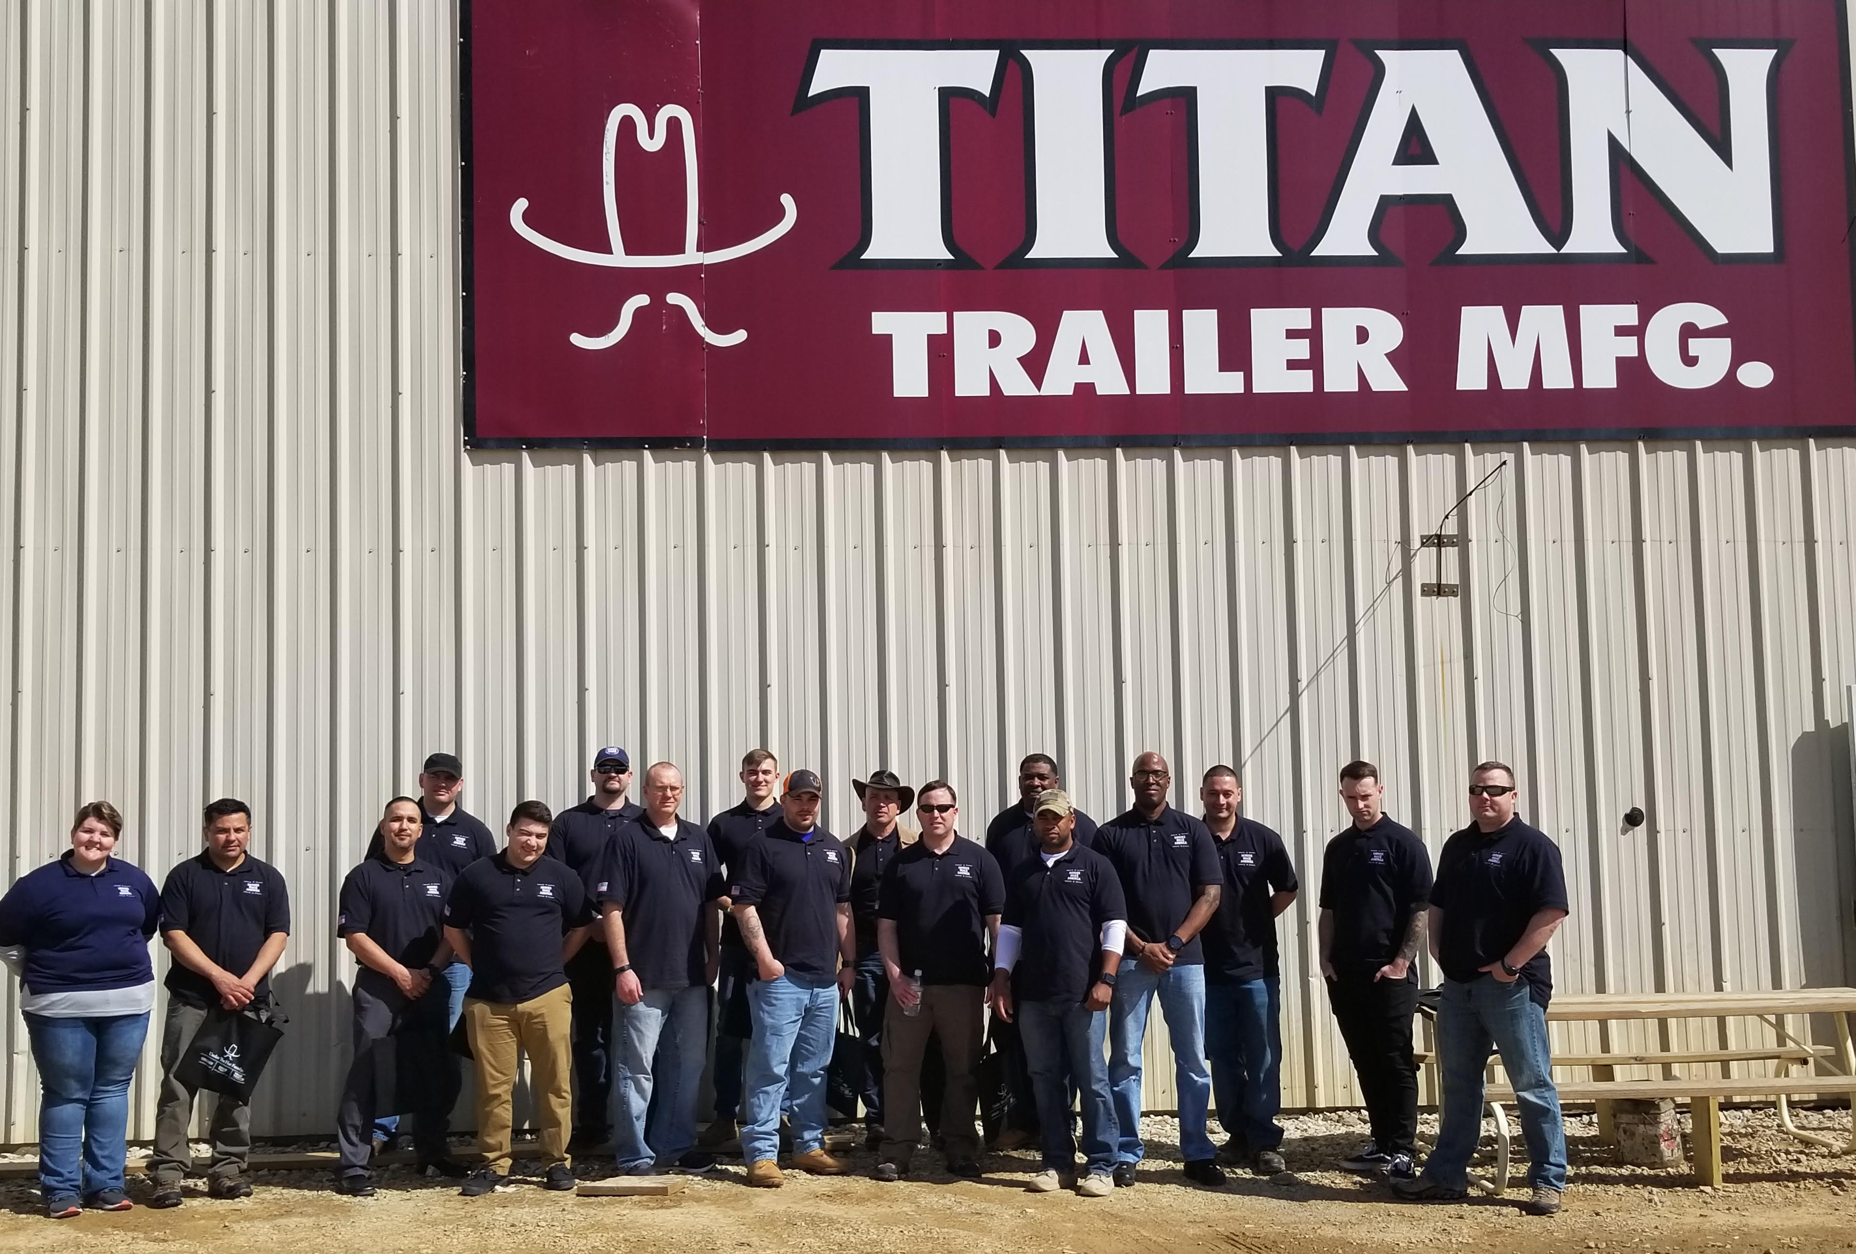

Slide 26
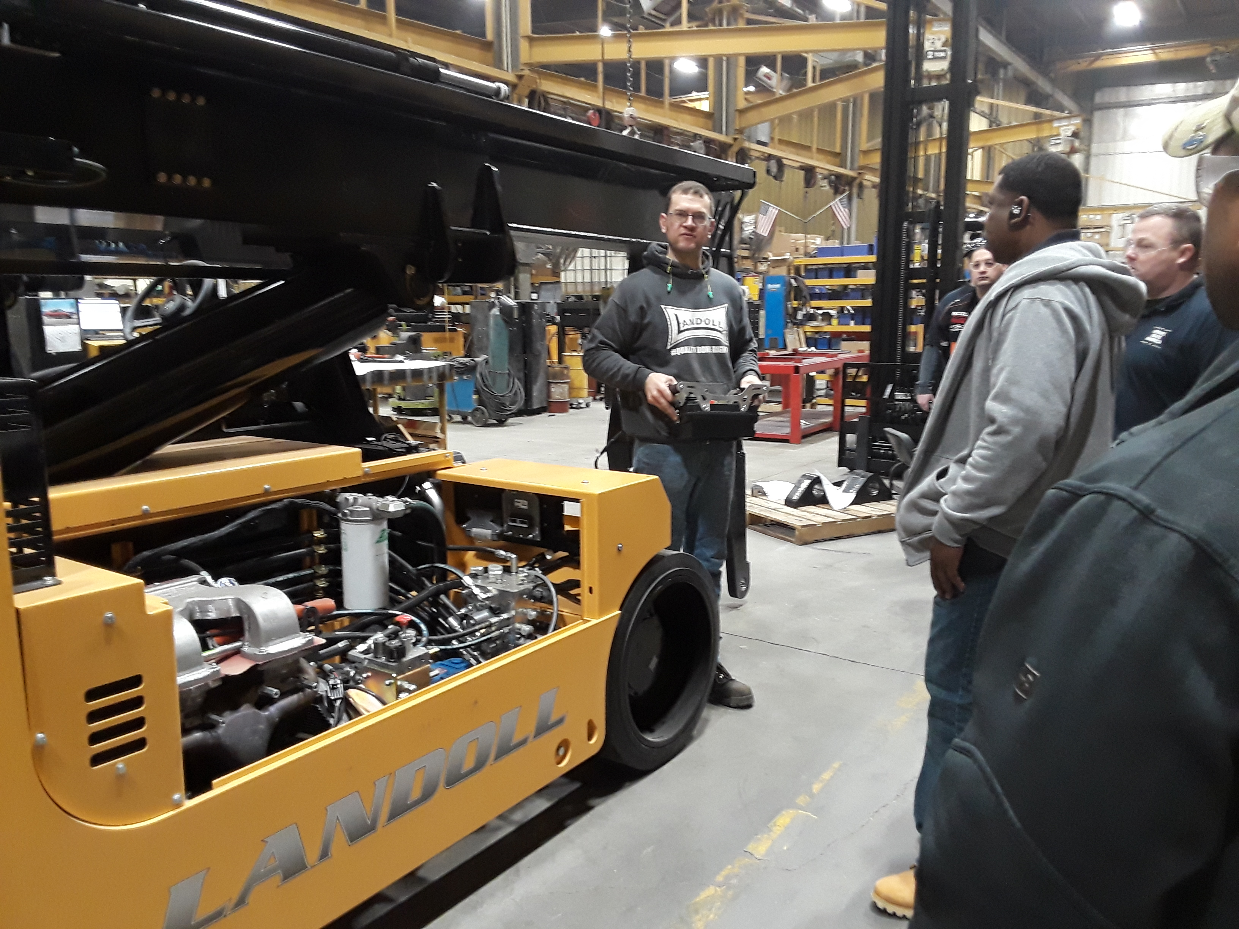

Slide 27
Besides Career Guidance, Transition Plus hopes to have
Affordable Housing and
Financial Counseling
Low rent Housing allows them to learn to save and manage their money for their new career
Housing also allows for them to still connect with their tribe so they are not so alone or different.

Slide 28
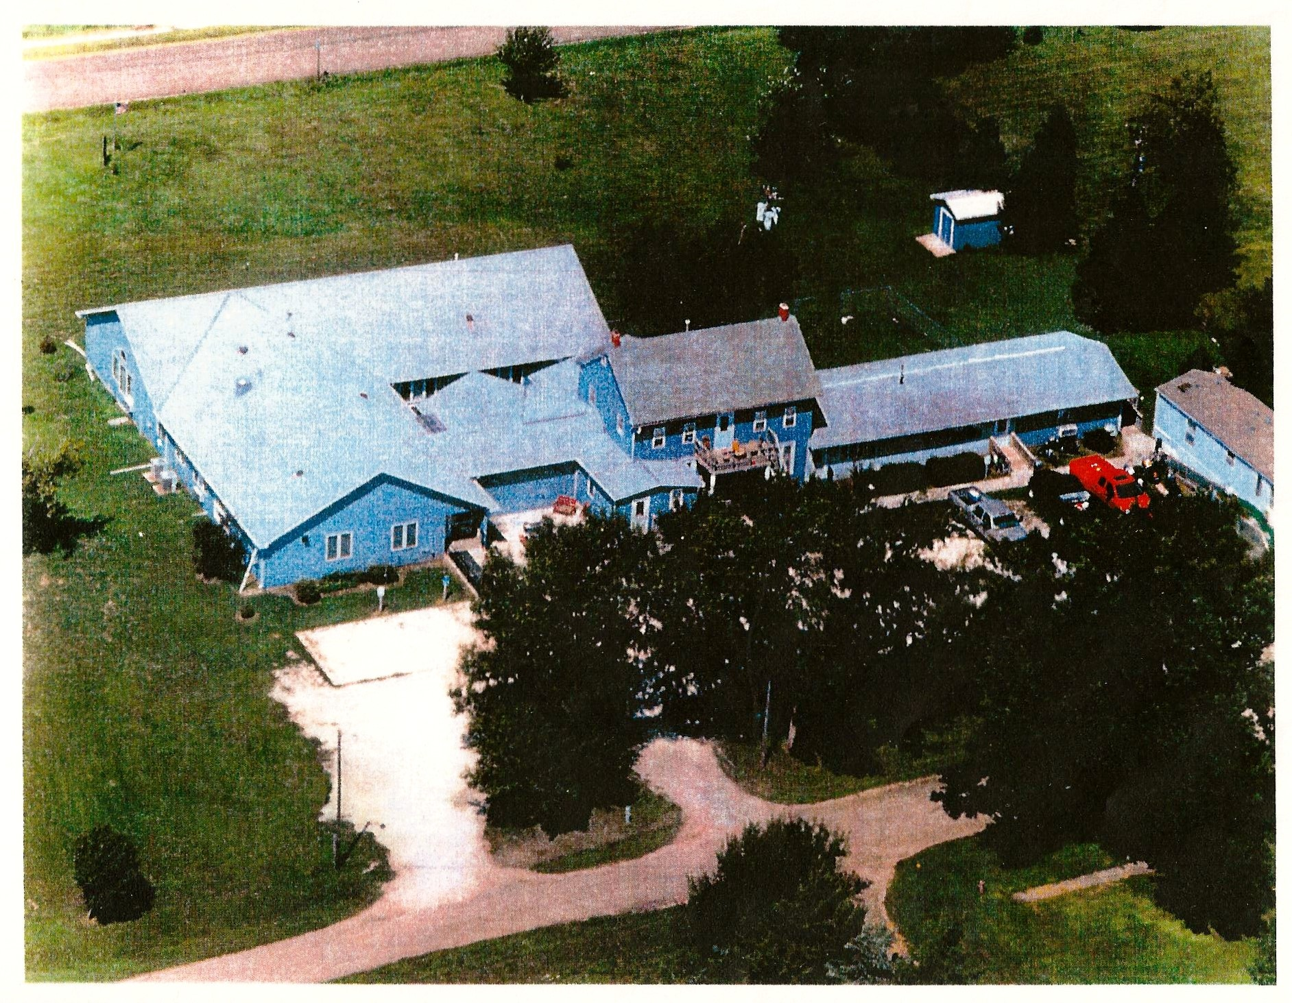
This is Another Piece – Possible Idea for Affordable Housing
Former Vet Home with 25 rooms

Slide 29
Need Medical Care –
Transition Plus
is working toward setting up for Telemedicine able to
access VA Hospitals and specialists.

Slide 30
Board Leadership–
President, Gary Smith, Kansas City
Former Colonel, Jerry Zayas from Blue Rapids
Eco Devo, Ellen Barber, Marshall County
Secretary
Treasurer, Dick Brumbaugh, Kansas City
Project Director, Lynn Sunderland
Former veteran chaplain specialty in mental health, Jim McNeil
Ryan Woodyard, Blue Rapids Police Force

Slide 31
Partnerships
USO excited to promote Transition Plus to the transitioning military from Ft. Riley, Leavenworth and Omaha
Department of Commerce Community Service Tax Credits Partnership and the Donors, Community College Partnerships,
Developing a Telemed Partnership,
Tech Assistance for Tower Farming, Lincoln Farm
Farm Bureau – 10k grant for a Greenhouse
SAVE Farm – Manhattan, KS

Slide 32
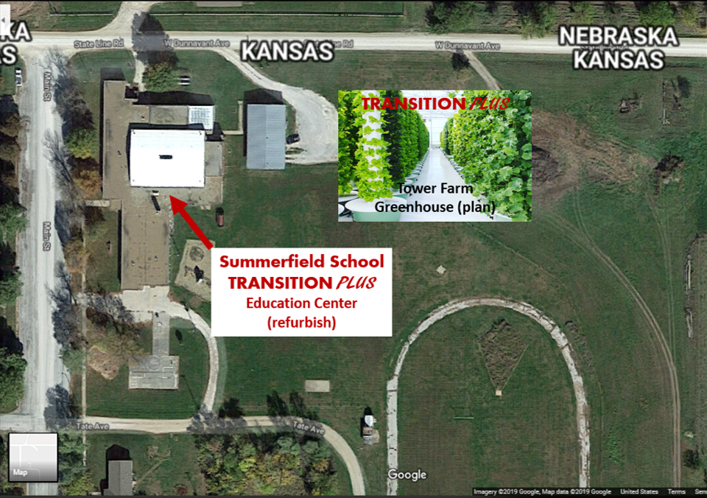
Former School Building – Leased from the City of
Summerfield

Slide 33
August 2019 -
Tax Credits Awarded at $300,000 -
School Renovation and Tower Farm Start Up with Indoor and Outdoor Commercial Greenhouse
Shared Community Kitchen

Slide 34
Plan that is Reproducible – This is the prototype
Empty consolidated school buildings in rural areas are everywhere. Need a new purpose!
Need for healthy farm-to-table food grown locally is needed everywhere!
Need for Telemedicine in the rural areas is needed for better care – lower costs and better access

Slide 35
Veterans need time to transition to civilian life with career discovery and healing to be successful!
That can happen with
Transition Plus!

Slide 36
Training Veterans -
Transforming Rural Communities
Affordable Housing
High Tech Healthy Food Growth
Ag Business Careers that are affordable
Telemedicine for Specialized Health Care
Online GI Bill Ed Career Options

